Slide 1
HAPPIEST HEALTH DIGITAL TWIN CHALLENGE 2026
CardioTwin AI
Personalized Cardiovascular Digital Twin & Early Risk Prediction
Sathiyamoorthi S (Team Leader) | Omprakash S
V.S.B College of Engineering Technical Campus, Coimbatore, Tamil Nadu
Live demo: cardio-twin-ai-rose.vercel.app
Research prototype using synthetic or appropriately licensed data.
Notes:
Welcome. CardioTwin AI is our entry to the Happiest Health Digital Twin Challenge 2026. It is an educational and research prototype that combines historical health context with simulated wearable signals inside a software digital twin. Everything you will see uses synthetic or appropriately licensed anonymized data, and nothing here is clinical.

Slide 2




Executive Summary
Problem
Solution
Intelligence
Value
Historical records and dynamic wearable signals are hard to interpret together.
A simulated, patient-specific digital-twin state that fuses both sources.
Temporal features feed a trained ML model for one defined outcome and horizon.
A transparent, interactive dashboard to explore physiological patterns.
Scope: a research workflow on synthetic or licensed anonymized data. Not a diagnostic tool.
Notes:
The story in four steps. The problem: historical records and dynamic wearable data are hard to read together. The solution: a simulated, patient-specific digital-twin state. The intelligence: temporal features and a trained model for one defined outcome and horizon. The value: a transparent, interactive dashboard for exploring patterns.

Slide 3




Problem Statement
Two kinds of data
Patterns drift over time
Historical EHR records are static snapshots; wearables stream dynamic measurements.
Physiological signals change, so a single reading misses trends and personal baselines.
Data quality limits reliability
Predictions must be trustworthy
Missing values, duplicates, outliers and misaligned timestamps degrade models.
Outputs need explanations and evaluation free of patient or time leakage.
No prevalence or burden statistics are used on this slide; any added statistic must carry a citation.
Notes:
Four challenges motivate the project. Historical EHR data and wearable streams behave differently. Physiological patterns drift, so single readings miss trends. Data-quality problems undermine reliability. And any prediction must be interpretable and evaluated without patient or time leakage. We deliberately avoid quoting prevalence statistics here; any statistic added later needs a citation.

Slide 4
Proposed Healthcare Use Case
Combine synthetic historical records and simulated wearable signals to estimate elevated physiological-pattern risk over a 2-hour forward horizon.
Example user
Inputs
Processing
Output
A synthetic patient profile
No real individual
Generated or licensed anonymized
Historical features
Recent time-series observations
Timestamps and units
Validation checks
Temporal feature engineering
Baseline comparison
Experimental estimate + horizon
Explanation
Stated limitations
Research estimate only: not a diagnosis, not a prediction of an actual heart attack.
Notes:
One narrow research use case: combine synthetic historical records and simulated wearable signals to estimate a defined short-horizon physiological-pattern outcome. A synthetic patient goes in, validated and feature-engineered data is compared against a baseline, and the output is an experimental estimate with its horizon, an explanation, and its limitations. This is not diagnosis and not a prediction of a real heart attack.

Slide 5
Innovation and Differentiation
Capability | Kind | Status
Historical + dynamic data fusion | Core idea | IMPLEMENTED
Patient-specific baselines and time-series features | Core idea | IMPLEMENTED
Digital-twin snapshot history | Core idea | VERIFY
Data-quality and provenance visibility | Core idea | IMPLEMENTED
Explainable model output | Standard technique | VERIFY
Interactive what-if scenarios | Application feature | VERIFY
Multilingual UI: EN, TA, HI, ML, TE, KN | Accessibility feature | IMPLEMENTED
Light, dark and system themes | Standard UI feature | IMPLEMENTED
Implemented = visible in the live prototype. "Verify" = confirm in the demo or repository (e.g. all six languages).
Notes:
What is genuinely new is the combination: fusing historical context with dynamic data, keeping patient-specific baselines, and storing digital-twin snapshot history. Explainability, themes and multilingual support are standard techniques applied well, and we say so plainly. Status labels must be confirmed against the repository before presenting.

Slide 6
End-to-End System Architecture
DATA
1
Synthetic EHR source
2
Simulated wearable series
3
Data validation
IMPLEMENTED
IMPLEMENTED
VERIFY
INTELLIGENCE
4
Temporal feature engineering
5
Digital-twin state and snapshots
6
Trained ML model and inference
7
Explainability and evaluation
VERIFY
IMPLEMENTED
VERIFY
VERIFY
APPLICATION
8
Backend API and persistence
9
Interactive frontend and reports
VERIFY
IMPLEMENTED
Directional flow: sources, then validation, then features and twin state, then model, then API and dashboard. Confirm each stage status against the repository.
Notes:
Data flows top to bottom. Synthetic EHR and simulated wearable series are validated, then temporal features are built. The twin state and snapshots feed a trained model, followed by explainability and evaluation. A backend API persists results for the interactive frontend and reports. If this differs from docs/architecture.pdf, swap in the repository diagram and mark unimplemented parts honestly.

Slide 7
Data Sources and Preparation
Preparation steps
Illustrative synthetic example (not real data)
Patient | Time | HR bpm | SBP mmHg
CT-1001 | 08:00 | 68 | 122
CT-1001 | 08:05 | 71 | 121
CT-1001 | 08:10 | missing | 123
Source: synthetic or licensed anonymized (name it)
Fields and units: in a feature dictionary
Timestamps aligned to a common grid
Missing values: flagged, then imputed or masked
Duplicate and outlier checks
Features: rolling statistics, deltas vs baseline
Figure 7. Example rows only. The missing HR value would be flagged by validation.
20 synthetic patient twins
Count shown in the app. Observation totals: pending data profile.
Privacy: no real patient records; no keys or passwords in slides.
Notes:
The data is synthetic or appropriately licensed anonymized data. We document fields and units, align timestamps, flag missing values, check duplicates and outliers, and construct rolling and baseline features. The table is an illustrative synthetic example, not real data, and dataset counts will be filled from the verified data profile rather than estimated.

Slide 8
Digital-Twin Design
1
2
3
4
Snapshot 1
Snapshot 2
Snapshot 3
Snapshot 4
Baseline set
New readings
Features updated
Model re-run
Historical context
Recent observations
Baseline and rolling features
Snapshot timestamp
Freshness and missingness
Model version + prediction
Figure 8. Illustrative snapshot structure and timeline, not actual snapshot data.
A research representation, not a validated physiological replica.
Notes:
The twin is a software representation of a synthetic patient that changes over time. Each snapshot stores historical context, recent observations, baseline and rolling features, a timestamp, data freshness and missingness, and the model version with its prediction. The timeline is illustrative. This is a research representation, not a validated physiological replica.

Slide 9
AI/ML Pipeline
PLANNED
1
2
3
4
5
6
Define target
Preprocess
Baseline
Candidate
Validate
Infer and log
Elevated risk, 2 h
Impute, scale, encode
Simple, interpretable
Non-linear tabular
Grouped, time-aware
Versioned output
Leakage prevention
Models (proposed, confirm)
Patient-grouped train/test split
Time-ordered validation windows
Fit transformers on training data only
Baseline: logistic regression
Candidate: gradient-boosted trees
Library: scikit-learn
Notes:
This slide is the planned methodology until the model is trained. Define a binary target and horizon, preprocess, fit an interpretable baseline, fit a candidate model, validate with patient-grouped and time-aware splits, then log versioned predictions. Replace the proposed model names with those actually used.

Slide 10
Evaluation and Results
EVALUATION PENDING
Evaluation protocol
Results table (to be populated from evaluation output)
Metric | Baseline | Candidate
Precision | pending | pending
Recall | pending | pending
F1-score | pending | pending
AUROC | pending | pending
AUPRC | pending | pending
Brier score | pending | pending
Patient-grouped, time-aware split
Precision, recall, F1, AUROC, AUPRC
Calibration curve and Brier score
Baseline vs candidate, same folds
Confusion matrix at a stated threshold
No score is displayed until it is traceable to saved evaluation output.
Notes:
No scores are shown because evaluation is not complete, and we will not manufacture numbers. The protocol is: patient-grouped, time-aware validation; precision, recall, F1, AUROC and AUPRC; calibration and Brier score; and baseline versus candidate on identical folds. The table will be populated only from saved evaluation output.

Slide 11
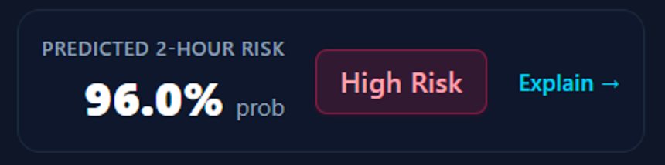
Explainability and Responsible Predictions
Conceptual example, not model output
Estimate: <value> within <horizon>
Top features: <ranked list>
Data freshness: <age of last reading>
Missing inputs: <list>
Uncertainty: <only if estimated>
Limitations: synthetic training data
Figure 11. Risk card from the live prototype (synthetic subject).
Estimate and horizon
Contributing features, if computed
Freshness and missing inputs
Uncertainty, only if estimated
Training-data limitations
Notes:
Every estimate is shown with its horizon, the features that contributed most if computed, data freshness, missing inputs, uncertainty only if estimated, and the training-data limitations. The card on the left is a conceptual layout, not real model output.

Slide 12
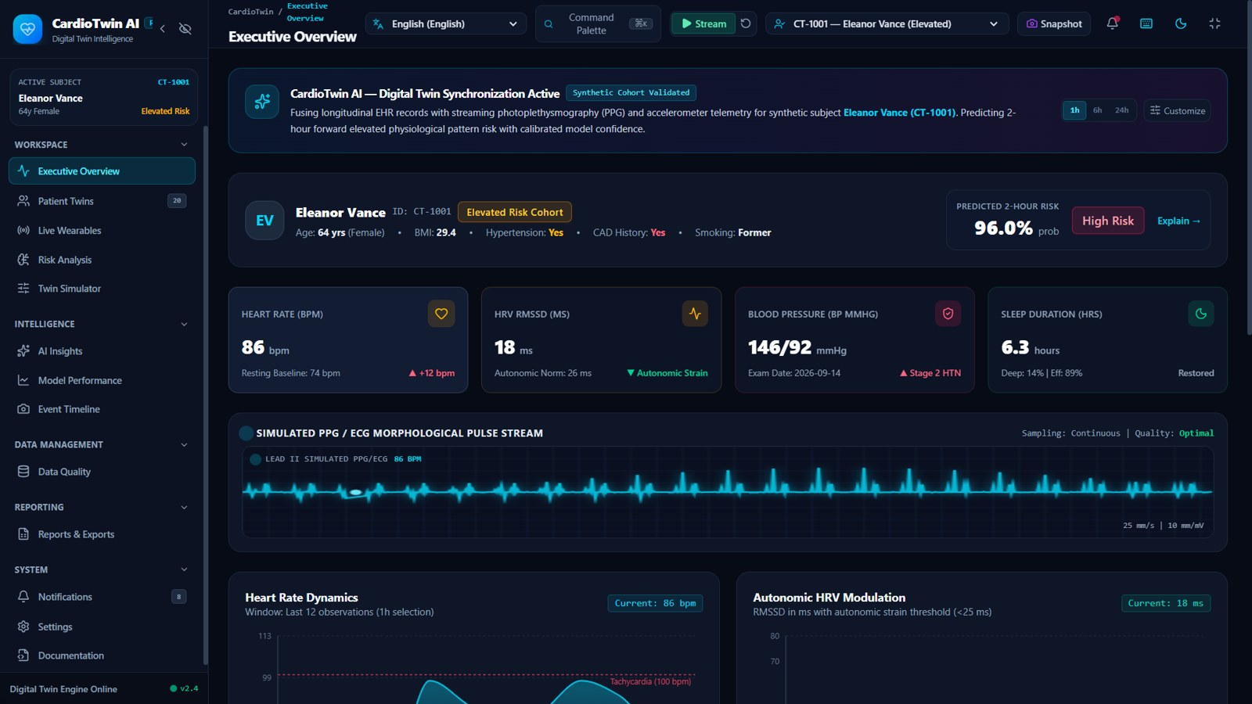
Application Dashboard and User Journey
1
Select a synthetic patient
2
Review historical information
3
Inspect wearable trends
4
View latest twin state
5
Request or inspect a model estimate
6
Review model explanations
7
Run a hypothetical scenario
Figure 12. Executive Overview in the live prototype (synthetic subject CT-1001). Steps 1-5 are visible here; steps 6-8 use the Explain, Twin Simulator and Reports pages.
8
Export a report, if implemented
Live demo: cardio-twin-ai-rose.vercel.app
Notes:
The user journey has eight steps: select a synthetic patient, review history, inspect wearable trends, view the latest twin state, request a model estimate, review explanations, run a what-if scenario, and export a report if implemented. Insert real screenshots; label any unbuilt screen as a proposed design.

Slide 13
Advanced Features and Accessibility
Feature | Status | Test evidence
Multilingual user interface | IMPLEMENTED | Language selector, Fig. 12
Light, dark and system themes | IMPLEMENTED | Theme toggle, Fig. 12
Expandable, collapsible, hidden sidebar | IMPLEMENTED | Sidebar controls, Fig. 12
Responsive layout, keyboard access | VERIFY | Add test (command palette seen)
Simulated real-time wearable stream | IMPLEMENTED | Stream button, PPG/ECG, Fig. 12
What-if simulator | VERIFY | Twin Simulator page: add screenshot
Data-quality dashboard | IMPLEMENTED | Data Quality page, Fig. 12
PDF, CSV and JSON exports | VERIFY | Reports and Exports: add test
A feature is claimed only after it has been tested.
Notes:
This table lists capabilities and what evidence supports each. We only claim a feature once it has been tested. Update the status and evidence columns from your test results.

Slide 14

Validation, Security, and Responsible Use
Safeguards
Not claimed
Synthetic or licensed anonymized data only
Patient and time leakage prevention
Input validation, missing-data handling
Authentication where implemented
Secrets in environment variables
No clinical validation
No diagnosis or treatment use
Synthetic-data scores do not transfer to patients
Not a validated physiological replica
Future clinical evaluation needs clinical expertise, ethics governance, real-data access and independent validation.
Notes:
Safeguards on the left: synthetic or anonymized data only, leakage prevention, input validation, API protections where implemented, and secrets kept out of slides and the repository. Right: what is explicitly not claimed. A future clinical evaluation would need clinical expertise, governance, data access and independent validation.

Slide 15

Outcomes, Limitations, and Roadmap
Completed
Limitations
Next steps
Live dashboard deployed on Vercel
20 synthetic patient twins
Simulated PPG/ECG stream and controls
Measured results: pending (slide 10)
Synthetic or licensed data only
No clinical validation
Prototype scale, single participant
No external validation yet
External validation
Better calibration
Additional data modalities
Accessibility improvements
Clinician-informed research
Notes:
Completed means verified only. Limitations are plain: synthetic data, no clinical validation, prototype scale. Next steps are external validation, better calibration, more data modalities, accessibility improvements and clinician-informed research.

Slide 16
Conclusion and Demo
Problem: historical + dynamic data are hard to read together
Contribution: transparent digital-twin research workflow
Status: research prototype, labeled per feature
Key measured finding: pending evaluation
GitHub: github.com/<username>/<repo>
Live demo: cardio-twin-ai-rose.vercel.app
Team: Sathiyamoorthi S (Leader), Omprakash S
Contact: <public email or profile>
CardioTwin AI explores how historical health context and dynamic wearable signals can be combined in a transparent digital-twin research workflow.
Notes:
To close: the problem is interpreting historical and dynamic data together. The contribution is a transparent digital-twin research workflow. The prototype status is honest and labeled. Measured findings will be reported once evaluation completes. Please see the repository and demo for details.

Slide 17
Appendix: Method References
Pedregosa et al. (2011). Scikit-learn: Machine Learning in Python. JMLR 12.
Lundberg & Lee (2017). A Unified Approach to Interpreting Model Predictions. NeurIPS.
Saito & Rehmsmeier (2015). The Precision-Recall Plot Is More Informative than the ROC Plot on Imbalanced Datasets. PLOS ONE 10(3).
Kaufman et al. (2012). Leakage in Data Mining. ACM TKDD 6(4).
Collins et al. (2015). TRIPOD statement. BMJ 350:g7594.
Mitchell et al. (2019). Model Cards for Model Reporting. FAT*.
Walonoski et al. (2018). Synthea. JAMIA 25(3). Cite only if Synthea is used.
Notes:
Cite only those that match what is actually implemented. Remove any reference not used.

Slide 18
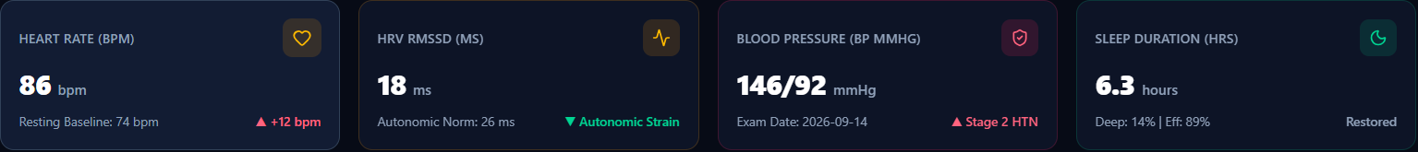
Appendix: Feature Dictionary
Field | Unit | Demo value (synthetic CT-1001)
Heart rate | bpm | 86 (resting baseline 74)
HRV (RMSSD) | ms | 18 (autonomic norm 26)
Blood pressure | mmHg | 146/92
Sleep duration | hours | 6.3 (deep 14%, efficiency 89%)
BMI | index | 29.4
Age | years | 64
History flags | yes / no | Hypertension, CAD history, smoking status
Figure A2. KPI strip and field values from the running prototype (synthetic data).
Notes:
Fields and units visible in the live prototype for the synthetic subject CT-1001. The strip is cropped from the running dashboard. Values are synthetic.

Slide 19
Appendix: Application Module Map
Workspace
Intelligence
Executive Overview
Patient Twins
Live Wearables
Risk Analysis
Twin Simulator
AI Insights
Model Performance
Event Timeline
Data and Reporting
System
Data Quality
Reports and Exports
Notifications
Settings
Documentation
Module names from the live UI sidebar; page functionality to be verified.
Notes:
Module names are taken from the live interface sidebar. Each page should be demonstrated or tested before being claimed as working.

